Slide 1

Motivation Theories
Deema Al-Badawi
Asia Al-Barghothi
Qusai Rahhal
Mahmoud Rummaneh

Slide 2

Definition
Motivation is the process of influencing someone of doing something or it is the state of being eager to work or act.
Motivation is separated into two categories:
Internal
External.

Slide 3

Internal motivation
Internal motivation is that you acquire your motivation to achieve your goal from within you. It is determined by your own goals and values.
Examples
Achievement
Individual growth
Survival needs (food, clothes, etc.)

Slide 4

External motivation
External motivation is that your motivation to accomplish your goal whether it’s to gain a reward or to avoid a punishment, comes from an external source, in other words, outside yourself.
Examples
Money
Praise
Promotion/Recognition

Slide 5
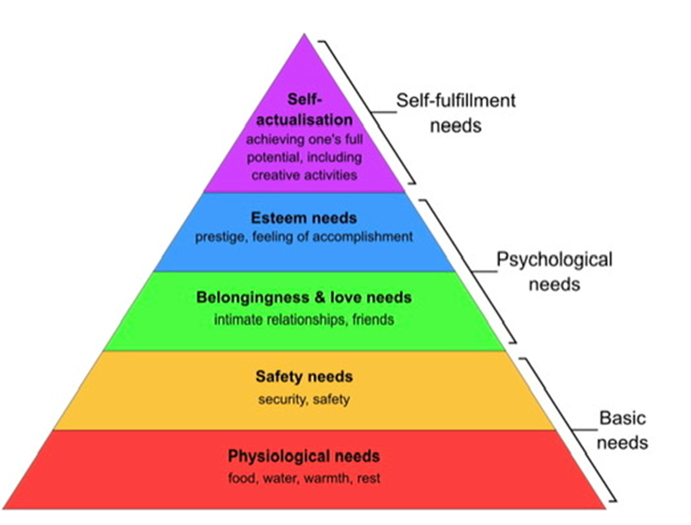
Maslow’s theory
Maslow's theory describes his hierarchy of needs as a pyramid, with basic needs at the bottom and higher-level, intangible needs at the top. When a person's basic needs are fulfilled, he or she can progress to meeting higher-level needs.
Maslow proposed that motivation arises from an individual's attempt to meet five basic needs:
physiological
self-actualization.
Safety
Social
Esteem

Slide 6

Herzberg’s Motivation-Maintenance Theory
One of the content theories of motivation is Herzberg's theory of motivation.
These theories attempt to explain the factors that motivate individuals through the identification and satisfaction of their individual needs, desires, and goals pursued to satisfy those desires.
This theory of motivation is known as the two-factor content theory.

Slide 7
Differences between the two theories
 | Maslow’s theory | Herzberg’s Motivation-Maintenance Theory
Meaning | Theory is based on the concept of humans’ satisfaction and their needs. | Theory is based on how motivators deal which contain opportunity for growth & recognition, and achievement.
Basis of theory | Theory depends on the hierarchy of human needs. | Theory points at motivating factors and hygiene factors
Nature of theory | Theory is sort of descriptive and simple. | Theory is quite prescriptive.
Applicability of theory | Theory is considered more popular and more applicable. | Theory is an extension of Maslow’s theory and its less applicable.

Slide 8

Thank You

